Slide 1

Capital Budgeting
Msc Corporate Financial Management
Lille Campus - 18 hours
Skema Business School
Step 1 : Calculate Cash Flows
Fundamentals of Capital Budgeting
Pr. Sébastien DEREEPER
Sebastien.Dereeper@skema.edu
Course Based on :
J. Berk & P. De Marzo - Corporate Finance - Pearson, 2024
Notes:
If this PowerPoint presentation contains mathematical equations, you may need to check that your computer has the following installed:
1) Math Type Plugin
2) Math Player (free versions available)
3) NVDA Reader (free versions available)

Slide 2
Outline
1. Forecasting Earnings
2. Determining Free Cash Flow and N P V
3. Choosing Among Alternatives
4. Further Adjustments to Free Cash Flow
5. Analyzing the Project
Prerequisites : - Financial Mathematics
- Company Statements Knowledge
- M1 Corporate Finance course

Slide 3
Learning Objectives (1 of 2)
Given a set of facts, identify relevant cash flows for a capital budgeting problem.
Explain why opportunity costs must be included in cash flows, while sunk costs and interest expense must not.
Calculate taxes that must be paid, including tax loss carryforwards and carrybacks.

Slide 4
Learning Objectives (2 of 2)
Calculate free cash flows for a given project.
Illustrate the impact of depreciation expense on cash flows.
Describe the appropriate selection of discount rate for a particular set of circumstances.
Use breakeven analysis, sensitivity analysis, or scenario analysis to evaluate project risk.

Slide 5
1. Forecasting Earnings
Capital Budget
  Lists the investments that a company plans to undertake
Capital Budgeting
  Process used to analyze alternate investments and decide which ones to accept
Incremental Earnings
  The amount by which the firm’s earnings are expected to change as a result of the investment decision

Slide 6
Revenue and Cost Estimates
Homenet Example 1 (1 of 2)
Example
  Linksys has completed a $300,000 feasibility study to assess the attractiveness of a new product, HomeNet. The project has an estimated life of four years
  Revenue Estimates
    Per Unit Price = $260

Slide 7
Revenue and Cost Estimates (2 of 2)
Example
  Cost Estimates
    Up-Front R & D = $15,000,000
    Up-Front New Equipment = $7,500,000
      Expected life of the new equipment is five years
      Housed in existing lab
    Annual Overhead = $2,800,000
    Per Unit Cost = $110

Slide 8
Incremental Earnings Forecast
Table 1
Blank | Year | 0 | 1 | 2 | 3 | 4 | 5
Incremental Earnings Forecast ($000s) | Blank | Blank | Blank | Blank | Blank | Blank | Blank
1 Sales | Blank | Blank | 26,000 | 26,000 | 26,000 | 26,000 | Blank
2 Cost of Goods Sold | Blank | Blank | (11,000) | (11,000) | (11,000) | (11,000) | Blank
3 Gross Profit | Blank | Blank | 15,000 | 15,000 | 15,000 | 15,000 | Blank
4 Selling, General, and Administrative | Blank | Blank | (2,800) | (2,800) | (2,800) | (2,800) | Blank
5 Research and Development | Blank | (15,000) | Blank | Blank | Blank | Blank | Blank
6 Depreciation | Blank | Blank | (1,500) | (1,500) | (1,500) | (1,500) | (1,500)
7 E B I T | Blank | (15,000) | 10,700 | 10,700 | 10,700 | 10,700 | (1,500)
8 Income Tax at 20% | Blank | 3,000 | (2,140) | (2,140) | (2,140) | (2,140) | 300
9 Unlevered Net Income | Blank | (12,000) | 8,560 | 8,560 | 8,560 | 8,560 | (1,200)

Slide 9
Capital Expenditures and Depreciation
The $7.5 million in new equipment is a cash expense, but it is not directly listed as an expense when calculating earnings
  Instead, the firm deducts a fraction of the cost of these items each year as depreciation
Straight Line Depreciation
  The asset’s cost is divided equally over its life. Annual Depreciation

Slide 10
Interest Expense
In capital budgeting decisions, interest expense is typically not included
The rationale is that the project should be judged on its own, not on how it will be financed

Slide 11
Taxes (1 of 2)
Marginal Corporate Tax Rate
  The tax rate on the marginal or incremental dollar of pre-tax income
    Note: A negative tax is equal to a tax credit

Slide 12
Taxes (2 of 2)
Unlevered Net Income Calculation

Slide 13
Indirect Effects on Incremental Earnings (1 of 4)
Opportunity Cost
  The value a resource could have provided in its best alternative use
  In the HomeNet project example, space will be required for the investment
  Even though the equipment will be housed in an existing lab, the opportunity cost of not using the space in an alternative way (e.g., renting it out) must be considered

Slide 14
Homenet Example 2 (1 of 2)
The Opportunity Cost of HomeNet’s Lab Space
Problem
Suppose HomeNet’s new lab will be housed in warehouse space that the company would have otherwise rented out for $200,000 per year during years 1 – 4. How does this opportunity cost affect HomeNet’s incremental earnings?

Slide 15
Homenet Example 2 (2 of 2)
Solution
In this case, the opportunity cost of the warehouse space is the forgone rent. This cost would reduce HomeNet’s
incremental earnings during years 1 – 4 by
the after-tax benefit of renting
out the warehouse space.

Slide 16
Indirect Effects on Incremental Earnings (2 of 4)
Project Externalities
  Indirect effects of the project that may affect the profits of other business activities of the firm
  Cannibalization is when sales of a new product displaces sales of an existing product

Slide 17
Indirect Effects on Incremental Earnings (3 of 4)
Project Externalities
  In the HomeNet project example, 25% of sales come from customers who would have purchased an existing Linksys (revenue loss for 25,000 units at 100 $) wireless router if HomeNet were not available
  Because this reduction in sales of the existing wireless router is a consequence of the decision to develop HomeNet, we must include it when calculating HomeNet’s incremental earnings (cost gain for 25 units at 60$)

Slide 18
Indirect Effects on Incremental Earnings (4 of 4)
Table 2
Blank | Year | 0 | 1 | 2 | 3 | 4 | 5
Incremental Earnings Forecast ($000s) | Blank | Blank | Blank | Blank | Blank | Blank | Blank
1 Sales | Blank | Blank | 23,500 | 23,500 | 23,500 | 23,500 | Blank
2 Cost of Goods Sold | Blank | Blank | (9,500) | (9,500) | (9,500) | (9,500) | Blank
3 Gross Profit | Blank | Blank | 14,000 | 14,000 | 14,000 | 14,000 | Blank
4 Selling, General, and Administrative | Blank | Blank | (3,000) | (3,000) | (3,000) | (3,000) | Blank
5 Research and Development | Blank | (15,000) | Blank | Blank | Blank | Blank | Blank
6 Depreciation | Blank | Blank | (1,500) | (1,500) | (1,500) | (1,500) | (1,500)
7 E B I T | Blank | (15,000) | 9,500 | 9,500 | 9,500 | 9,500 | 9,500
8 Income Tax at 20% | Blank | 3,000 | (1,900) | (1,900) | (1,900) | (1,900) | 300
9 Unlevered Net Income | Blank | (12,000) | 7,600 | 7,600 | 7,600 | 7,600 | (1,200)

Slide 19
Sunk Costs and Incremental Earnings (1 of 4)
Sunk costs are costs that have been or will be paid regardless of the decision whether or not the investment is undertaken
  Sunk costs should not be included in the incremental earnings analysis

Slide 20
Sunk Costs and Incremental Earnings (2 of 4)
Fixed Overhead Expenses
  Typically overhead costs are fixed and not incremental to the project and should not be included in the calculation of incremental earnings

Slide 21
Sunk Costs and Incremental Earnings (3 of 4)
Past Research and Development Expenditures
  Money that has already been spent on R & D is a sunk cost and therefore irrelevant
  The decision to continue or abandon a project should be based only on the incremental costs and benefits of the product going forward

Slide 22
Sunk Costs and Incremental Earnings (4 of 4)
Unavoidable Competitive Effects
  When developing a new product, firms may be concerned about the cannibalization of existing products
  However, if sales are likely to decline in any case as a result of new products introduced by competitors, then these lost sales should be considered a sunk cost

Slide 23
Real-World Complexities
Typically,
  sales will change from year to year
  the average selling price will vary over time
  the average cost per unit will change over time

Slide 24
Homenet Example 3 (1 of 3)
Product Adoption and Price Changes
Problem
Suppose sales of HomeNet were expected to be 100,000 units in year 1, 125,000 units in years 2 and 3, and 50,000 units in year 4. Suppose also that HomeNet’s sale price and manufacturing cost are expected to decline by 10% per year, as with other networking products. By contrast, selling, general, and administrative expenses are expected to rise with inflation by 4% per year. Update the incremental earnings forecast in the spreadsheet in Table 2 to account for these effects.

Slide 25
Homenet Example 3 (2 of 3)
Solution
Home Net’s incremental earnings with these new assumptions are shown in the spreadsheet below:
Table 3
Year | 0 | 1 | 2 | 3 | 4 | 5
Incremental Earnings Forecast ($000s) | Blank | Blank | Blank | Blank | Blank | Blank
1 Sales | Blank | 23,500 | 26,438 | 23,794 | 8,566 | Blank
2 Cost of Goods Sold | Blank | (9,500) | (10,688) | (9,619) | (3,463) | Blank
3 Gross Profit | Blank | 14,000 | 15,750 | 14,175 | 5,103 | Blank
4 Selling, General, and Administrative | Blank | (3,000) | (3,120) | (3,245) | (3,375) | Blank
5 Research and Development | (15,000) | Blank | Blank | Blank | Blank | Blank
6 Depreciation | Blank | (1,500) | (1,500) | (1,500) | (1,500) | (1,500)
7 EBIT | (15,000) | 9,500 | 11,130 | 9,430 | 228 | (1,500)
8 Income Tax at 20% | 3,000 | (1,900) | (2,226) | (1,886) | (46) | 300
9 Unlevered Net Income | (12,000) | 7,600 | 8,904 | 7,544 | 183 | (1,200)

Slide 26
Homenet Example 3 (3 of 3)
For example, sale prices in year 2 will be
per unit for Home Net, and
for the
cannibalized product. Thus, incremental sales in year 2 are
equal to

Slide 27
2. Determining Free Cash Flow and N P V
The incremental effect of a project on a firm’s available cash is its free cash flow

Slide 28
Calculating the Free Cash Flow from Earnings (1 of 4)
Capital Expenditures and Depreciation
  Capital Expenditures are the actual cash outflows when an asset is purchased
    These cash outflows are included in calculating free cash flow
  Depreciation is a non-cash expense
    The free cash flow estimate is adjusted for this non-cash expense

Slide 29
Calculating the Free Cash Flow from Earnings (3 of 4)
Net Working Capital (N W C)
  Most projects will require an investment in net working capital
    Trade credit is the difference between receivables
    and payables
  The increase in net working capital is defined as

Slide 30
Calculating the Free Cash Flow from Earnings (4 of 4)
Table 4 : HomeNet’s Net Working Capital Requirements
Year | 0 | 1 | 2 | 3 | 4 | 5
Net Working Capital Forecast ($000s) | Blank | Blank | Blank | Blank | Blank | Blank
1 Cash Requirements | Blank | Blank | Blank | Blank | Blank | Blank
2 Inventory | Blank | Blank | Blank | Blank | Blank | Blank
3 Receivables (15% of Sales) | Blank | 3,525 | 3,525 | 3,525 | 3,525 | Blank
4 Payables (15% of COGS) | Blank | (1,425) | (1,425) | (1,425) | (1,425) | Blank
5 Net Working Capital | Blank | 2,100 | 2,100 | 2,100 | 2,100 | Blank

Slide 31
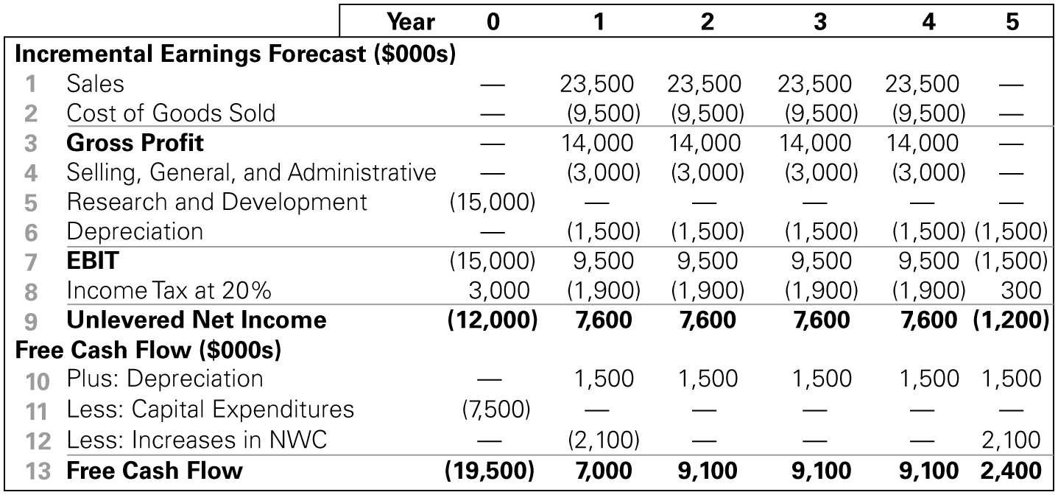
Calculating the Free Cash Flow from Earnings (2 of 4)
Table 5
Table 5 is our anchor table to continue the Homenet example
Notes:
Long Description:
The table shows the following: Incremental Earnings: Forecast, thousand dollars: 1, Sales, Year 0, blank; Year 1, 23,500; Year 2, 23,500; Year 3, 23,500; Year 4, 23,500; Year 5, blank; 2, Cost of Goods Sold: Year 0, blank; Year 1, left parenthesis 9,500 right parenthesis; Year 2, left parenthesis 9,500 right parenthesis; Year 3, left parenthesis 9,500 right parenthesis; Year 4, left parenthesis 9,500 right parenthesis; Year 5, blank; 3, Gross Profit: Year 0, blank; Year 1, 14,000; Year 2, 14,000; Year 3, 14,000; Year 4, 14,000; Year 5, blank; 4, Selling: General, and Administrative: Year 0, blank; Year 1, left parenthesis 3,000 right parenthesis; Year 2, left parenthesis 3,000 right parenthesis; Year 3, left parenthesis 3,000 right parenthesis; Year 4, left parenthesis 3,000 right parenthesis; Year 5, blank; 5, Research and Development: Year 0, left parenthesis 15,000 right parenthesis; Year 1, blank; Year 2, blank; Year 3, blank; Year 4, blank; Year 5, blank; 6, Depreciation: Year 0, blank; Year 1, left parenthesis 1,500 right parenthesis; Year 2, left parenthesis 1,500 right parenthesis; Year 3, left parenthesis 1,500 right parenthesis; Year 4, left parenthesis 1,500 right parenthesis; Year 5, left parenthesis 1,500 right parenthesis; 7, EBIT: Year 0, left parenthesis 15,000 right parenthesis; Year 1, 9,500; Year 2, 9,500; Year 3, 9,500; Year 4, 9,500; Year 5, left parenthesis 1,500 right parenthesis; 8, Income Tax at 20 percent: Year 0, 3,000; Year 1, left parenthesis 1,900 right parenthesis; Year 2, left parenthesis 1,900 right parenthesis; Year 3, left parenthesis 1,900 right parenthesis; Year 4, left parenthesis 1,900 right parenthesis; Year 5, 300; 9, Unlevered Net Income: Year 0, left parenthesis 12,000 right parenthesis; Year 1, 7,600; Year 2, 7,600; Year 3, 7,600; Year 4, 7,600; Year 5, left parenthesis 1,200 right parenthesis; Free Cash Flow, thousand dollars, 10, Plus, Depreciation, Year 0, blank; Year 1, left parenthesis 1,500 right parenthesis; Year 2, left parenthesis 1,500 right parenthesis; Year 3, left parenthesis 1,500 right parenthesis; Year 4, left parenthesis 1,500 right parenthesis; Year 5, left parenthesis 1,500 right parenthesis; 11, Less, Capital Expenditures, Year 0, left parenthesis 7,500 right parenthesis; Year 1, blank; Year 2, blank; Year 3, blank; Year 4, blank; Year 5, blank; 12, Research and Development: Year 0, blank; Year 1, left parenthesis 2,100 right parenthesis; Year 2, blank; Year 3, blank; Year 4, blank; Year 5, 2,100; 13, Research and Development, Year 0, left parenthesis 19,500 right parenthesis; Year 1, 7,000; Year 2, 9,100; Year 3, 9,100; Year 4, 9,100; Year 5, 2,400.

Slide 32
Calculating Free Cash Flow Directly
Free Cash Flow
  The term
  is called the depreciation
  tax shield
Notes:
Long Description:
Free cash flow equals left parenthesis revenues minus costs minus depreciation right parenthesis times left parenthesis 1 minus tau subscript c baseline right parenthesis plus depreciation minus CapEx minus delta N W C. Left parenthesis revenues minus cost minus depreciation right parenthesis times left parenthesis 1 minus tau subscript c baseline right parenthesis is labeled with curly brace as unlevered net income.

Slide 33
Calculating the N P V (1 of 2)
HomeNet N P V (W A C C = 12%)
Notes:
Long description 1:
P V left parenthesis F C F subscript t baseline right parenthesis equals start fraction F C F subscript t baseline over left parenthesis 1 plus r right parenthesis superscript t baseline end fraction equals F C F subscript t baseline times start fraction 1 over left parenthesis 1 plus r right parenthesis superscript t baseline end fraction. Brace, t equals year discount factor includes left parenthesis 1 plus r right parenthesis superscript t baseline.
Long description 2:
N P V equals negative 19500 plus start fraction 7000 over 1.12 end fraction plus start fraction 9100 over 1.12 superscript 2 baseline end fraction plus start fraction 9100 over 1.12 superscript 3 baseline end fraction plus start fraction 9100 over 1.12 superscript 4 baseline end fraction plus start fraction 2400 over 1.12 superscript 5 baseline end fraction.

Slide 34
Calculating the N P V (2 of 2)
Table 6 : Spreadsheet Computing HomeNet’s N P V
Blank | Year | 0 | 1 | 2 | 3 | 4 | 5
Net Present Value ($000s) | Blank | Blank | Blank | Blank | Blank | Blank | Blank
1 Free Cash Flow |  | (19,500) | 7,000 | 9,100 | 9,100 | 9,100 | 2,400
2 Project Cost of Capital | 12% | Blank | Blank | Blank | Blank | Blank | Blank
3 Discount Factor | Blank | 1 point 0 0 0 | 0 point 8 9 3 | 0 point 7 9 7 | 0 Point 7 1 2 | 0 point 6 3 6 | 0 point 5 6 7
4 P V of Free Cash Flow | Blank | (19,500) | 6,250 | 7,254 | 6,477 | 5,783 | 1,362
5 N P V | Blank | 7,627 | Blank | Blank | Blank | Blank | Blank
6 I R R | Blank | 27.9% | Blank | Blank | Blank | Blank | Blank

Slide 35
3. Choosing Among Alternatives (1 of 6)
Launching the HomeNet project produces a positive N P V, while not launching the project produces a 0 N P V

Slide 36
3. Choosing Among Alternatives (2 of 6)
Evaluating Manufacturing Alternatives
  In the HomeNet example, assume the company could produce each unit in-house for $95 if it spends $5 million upfront to change the assembly facility (versus $110 per unit if outsourced)
  The in-house manufacturing method would also require an additional investment in inventory equal to one month’s worth of production

Slide 37
3. Choosing Among Alternatives (3 of 6)
Evaluating Manufacturing Alternatives
  Outsource
      Investment in
        million in Year 1 and will
        increase by $1.65 million in Year 5
        N W C falls since this A/P is financed by suppliers

Slide 38
3. Choosing Among Alternatives (4 of 6)
Evaluating Manufacturing Alternatives
  In-House
    Cost per unit = $95
    Up-front cost of $5,000,000
    Investment in A/P = 15% of C O G S
        N W C will fall by $0.633 million in Year 1 and increase by $0.633 million in Year 5

Slide 39
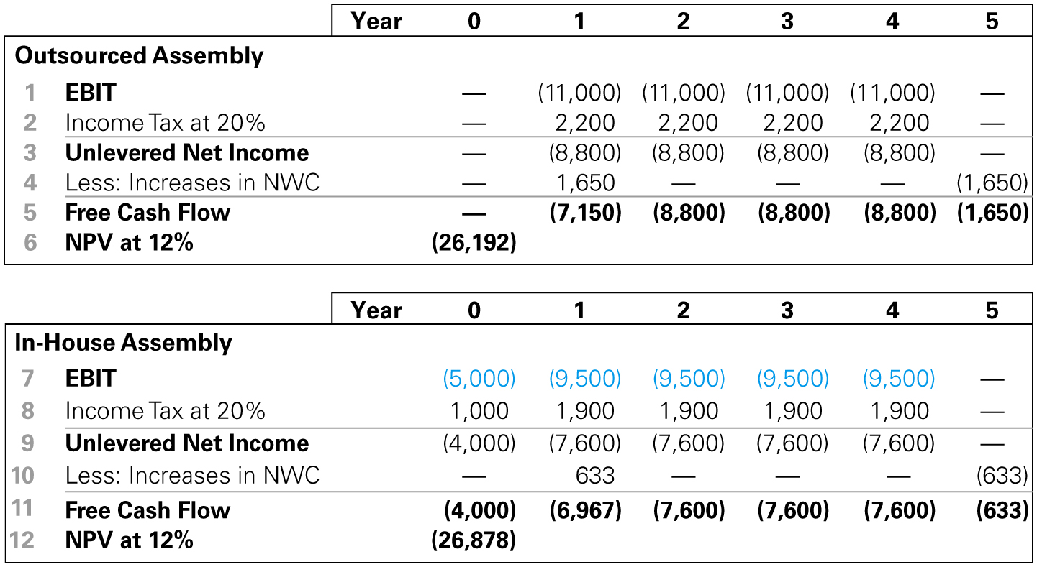
3. Choosing Among Alternatives (5 of 6)
Evaluating Manufacturing Alternatives
Table 7 : Spreadsheet N P V Cost of Outsourced Versus In-House Assembly of HomeNet
Notes:
Long Description:
The details of the outsource assembly for the years 0, 1, 2, 3, 4, and 5 are as follows: EBIT, blank, left parenthesis 11,000 right parenthesis, left parenthesis 11,000 right parenthesis, left parenthesis 11,000 right parenthesis, left parenthesis 11,000 right parenthesis, and blank; income tax at 20 percent, blank, 2,200, 2,200, 2,200, 2,200, and blank; unlevered net income, blank, left parenthesis 8,800 right parenthesis, left parenthesis 8,800 right parenthesis, left parenthesis 8,800 right parenthesis, left parenthesis 8,800 right parenthesis, and blank; less: increases in NWC, blank, 1,650, blank, blank, blank, and left parenthesis 1,650 right parenthesis; free cash flow, blank, left parenthesis 7,150 right parenthesis, left parenthesis 8,800 right parenthesis, left parenthesis 8,800 right parenthesis, left parenthesis 8,800 right parenthesis, and left parenthesis 1,650 right parenthesis; NPV at 12 percent, left parenthesis 26,192 right parenthesis. The details of the in-house assembly for the years 0, 1, 2, 3, 4, and 5 are as follows: EBIT, left parenthesis 5,000 right parenthesis, left parenthesis 9,500 right parenthesis, left parenthesis 9,500 right parenthesis, left parenthesis 9,500 right parenthesis, left parenthesis 9,500 right parenthesis, and blank; Income Tax at 20 percent, 1,000, 1,900, 1,900, 1,900, 1,900, and blank; Unlevered Net Income, left parenthesis 4,000 right parenthesis, left parenthesis 7,600 right parenthesis, left parenthesis 7,600 right parenthesis, left parenthesis 7,600 right parenthesis, left parenthesis 7,600 right parenthesis, and blank; Less: Increases in NWC, blank, 633, blank, blank, blank, and left parenthesis 633 right parenthesis; Free Cash Flow, left parenthesis 4,000 right parenthesis, left parenthesis 6,967 right parenthesis, left parenthesis 7,600 right parenthesis, left parenthesis 7,600 right parenthesis, left parenthesis 7,600 right parenthesis, and left parenthesis 633 right parenthesis; NPV at 12 percent, left parenthesis 26,878 right parenthesis, blank, blank, blank, blank, blank.

Slide 40
3. Choosing Among Alternatives (6 of 6)
Comparing Free Cash Flows Cisco’s Alternatives
  Outsourcing is the less expensive alternative

Slide 41
4. Further Adjustments to Free Cash Flow
Other Non-cash Items
  Amortization
Timing of Cash Flows
  Cash flows are often spread throughout the year
Accelerated Depreciation
  Modified Accelerated Cost Recovery System (M A C R S) depreciation

Slide 42
Homenet Example 4 (1 of 3)
Computing Accelerated Depreciation
Problem
What depreciation deduction would be allowed for HomeNet’s equipment using the M A C R S method, assuming the equipment is put into use by the end of year 0 and designated to have a five-year recovery period?

Slide 43
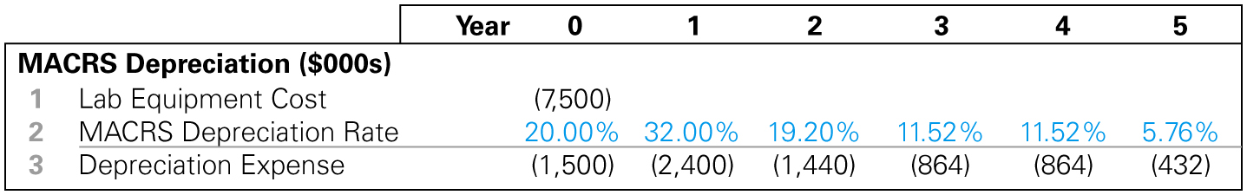
Homenet Example 4 (2 of 3)
Solution
Table A1 in the appendix provides the percentage of the cost that can be depreciated each year. Based on the table, the allowable depreciation expense for the lab equipment is shown below (in thousands of dollars):
Table 8
Notes:
Long Description:
The table shows the following data: MACRS Depreciation in thousand dollars; Lab Equipment Cost: Year 0, left parenthesis 7,500 right parenthesis; Year 1, blank; Year 2, blank; Year 3, blank; Year 4, blank; Year 5, blank; MACRS Depreciation Rate: Year 0, 20.00 percent; Year 1, 32.00 percent; Year 2, 19.20 percent; Year 3, 11.52 percent; Year 4, 11.52 percent; Year 5, 5.76 percent; Depreciation Expense: Year 0, left parenthesis 1,500 right parenthesis; Year 1, left parenthesis 2,400 right parenthesis; Year 2, left parenthesis 1,440 right parenthesis; Year 3, left parenthesis 864 right parenthesis; Year 4, left parenthesis 864 right parenthesis; Year 5, left parenthesis 432 right parenthesis.

Slide 44
Homent Example 4 (3 of 3)
As long as the equipment is put into use by the end of year 0, the tax code allows us to take our first depreciation expense in the same year. Compared with straight-line depreciation, the M A C R S method allows for larger depreciation deductions earlier in the asset’s life, which increases the present value of the depreciation tax shield and so will raise the project’s N P V.
Bonus depreciation would allow us to deduct the full $7.5 million cost of the equipment in year 0, accelerating the tax shield and increasing N P V even further.

Slide 45
Further Adjustments to Free Cash Flow (1 of 3)
Liquidation or Salvage Value

Slide 46
Homent Example 5 (1 of 3)
Adding Salvage Value to Free Cash Flow
Problem
Suppose that in addition to the $7.5 million in new equipment required for HomeNet, some equipment will be transferred to the lab from another Cisco facility. This equipment has a resale value of $2 million and a book value of $1 million. If the equipment is kept rather than sold, its remaining book value can be depreciated next year. When the lab is shut down in year 5, the equipment will have a salvage value of $800,000. What adjustments must we make to HomeNet’s free cash flow in this case?

Slide 47
Homenet Example 5 (2 of 3)
Solution
The existing equipment could have been sold for $2 million. The after-tax proceeds from this sale are an opportunity cost of using the equipment in the HomeNet lab. Thus, we must reduce HomeNet’s free cash flow in year 0 by the sale price less any taxes that would have been owed had the sale occurred:
In year 1, the remaining $1 million book value of the equipment can be
depreciated, creating a depreciation tax shield of
In year 5, the firm will sell the equipment for a salvage value of $800,000. Because the equipment will be fully depreciated at that time, the entire amount will be taxable as a capital gain, so the after-tax cash flow from the sale is
The spreadsheet below shows these adjustments to the free cash flow from the spreadsheet in Table 5 (anchor table) and recalculates HomeNet’s free cash flow and N P V in this case.

Slide 48
Homenet Example 5 (3 of 3)
Table 9
Blank | Year | 0 | 1 | 2 | 3 | 4 | 5
Free Cash Flow and N P V ($000s) | Blank | Blank | Blank | Blank | Blank | Blank | Blank
1 Free Cash Flow w/o equipment Adjustments for use of existing equipment | Blank | (19,500) | 7,000 | 9,100 | 9,100 | 9,100 | 2,400
2 After-Tax Salvage Value | Blank | (1,800) | Blank | Blank | Blank | Blank | 640
3 Depreciation Tax Shield | Blank | Blank | 200 | Blank | Blank | Blank | Blank
4 Free Cash Flow with equipment | Blank | (21,300) | 7,200 | 9,100 | 9,100 | 9,100 | 3,040
5 N P V at 12% | Blank | 6,368 | Blank | Blank | Blank | Blank | Blank

Slide 49
Further Adjustments to Free Cash Flow (2 of 3)
Terminal or Continuation Value
  This amount represents the market value of the free cash flow from the project at all future dates

Slide 50
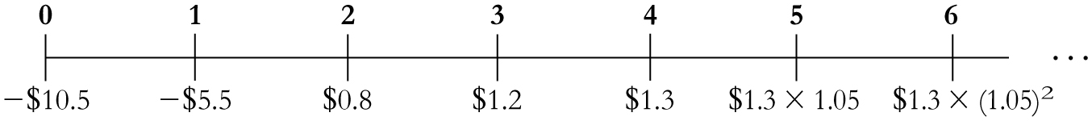
Base Hardware Example (1 of 3)
Problem
Base Hardware is considering opening a set of new retail stores. The free cash flow projections for the new stores are shown below (in millions of dollars):
After year 4, Base Hardware expects free cash flow from the stores to increase at a rate of 5% per year. If the appropriate cost of capital for this investment is 10%, what continuation value in year 4 captures the value of future free cash flows in year 5 and beyond? What is the N P V of the new stores?
Notes:
Long Description:
The number line ranges from 0 to 6 in unit increments. The data are as follows: 0, negative 10.5 dollars; 1, negative 5.5 dollars; 2, 0.8 dollars; 3, 1.2 dollars; 4, 1.3 dollars; 5, 1.3 dollars times 1.05; and 6, 1.3 dollars times 1.05 squared.

Slide 51
Base Hardware Example (2 of 3)
Solution
Because the future free cash flow beyond year 4 is expected to grow at 5% per year, the continuation value in year 4 of the free cash flow in year 5 and beyond can be calculated as a constant growth perpetuity:
Notice that under the assumption of constant growth, we can compute the continuation value as a multiple of the project’s final free cash flow.

Slide 52
Base Hardware Example (3 of 3)
We can restate the free cash flows of the investment as follows (in thousands of dollars):
Table 10
Year | 0 | 1 | 2 | 3 | 4
Free cash Flow (years0-4) | (10,500) | (5,500) | 800 | 1,200 | 1,300
Continuation value | Blank | Blank | Blank | Blank | 27,300
Free cash flow | (10,500) | (5,500) | 800 | 1,200 | 28,600
The N P V of the investment in the new stores is
or $5.597 million
Notes:
Long description:
N P V equals negative 10500 minus start fraction 5500 over 1.10 end fraction plus start fraction 800 over 1.10 superscript 2 baseline end fraction plus start fraction 1200 over 1.10 superscript 3 baseline end fraction plus start fraction 28600 over 1.10 superscript 4 baseline end fraction equals 5597 dollars.

Slide 53
Further Adjustments to Free Cash Flow (3 of 3)
Tax Carryforwards
  Tax loss carryforwards and carrybacks allow corporations to take losses during its current year and offset them against gains in nearby years

Slide 54
Verian Industries Example (1 of 3)
Tax Loss Carry forwards
Problem
Verian Industries has a net operating loss of $140 million this year. If Verian earns $50 million per year in pre-tax income from now on, what will its taxable income be over the next 4 years? If Verian earns an extra $10 million in the coming year, in which years will its taxable income increase?

Slide 55
Verian Industries Example(2 of 3)
Solution
With pre-tax income of $50 million per year, Verian will be able to use its tax loss carryforwards to reduce its taxable
income by
million each year:
A US rule
Table 11
Blank | Year | 0 | 1 | 2 | 3 | 4 | 5
Pre-tax Income | Blank | (140) | 50 | 50 | 50 | 50 | 50
Tax Loss Carryforward | Blank | Blank | (40) | (40) | (40) | (20) | Blank
Taxable Income | Blank | Blank | 10 | 10 | 10 | 30 | 50

Slide 56
Verian Industries Example (3 of 3)
If Verian earns an additional $10 million the first year, it will owe taxes on an extra $2 million next year and $8 million in year 4:
Table 12
Blank | Year | 0 | 1 | 2 | 3 | 4 | 5
Pre-tax Income | Blank | (140) | 60 | 50 | 50 | 50 | 50
Tax Loss Carryforward | Blank | Blank | (48) | (40) | (40) | (12) | Blank
Taxable Income | Blank | Blank | 12 | 10 | 10 | 38 | 50
Thus, when a firm has tax loss carryforwards, the tax impact of a portion of current earnings will be delayed until the carryforwards are exhausted. This delay reduces the present value of the tax impact, and firms sometimes approximate the effect of tax loss carryforwards by using a lower marginal tax rate.

Slide 57
5. Analyzing the Project (1 of 2)
Break-Even Analysis
  The break-even level of an input is the level that causes the N P V of the investment to equal zero
  HomeNet I R R Calculation
HomeNet I R R Calculation
Table 13
Year | 0 | 1 | 2 | 3 | 4 | 5
N P V ($000s) and IRR | Blank | Blank | Blank | Blank | Blank | Blank
1 Free cash flow | (19,500) | 7,000 | 9,100 | 9,100 | 9,100 | 2,400
2 N P V at 12% | 7,627 | Blank | Blank | Blank | Blank | Blank
3 I R R | 27.9% | Blank | Blank | Blank | Blank | Blank

Slide 58
5. Analyzing the Project (2 of 2)
Break-Even Analysis
  Break-Even Levels for HomeNet
Table 14 : Break-Even Levels for HomeNet
Parameter | Year
Units sold | 77,121 units per year
Wholesale price | $228 per unit
Cost of goods | $142 per unit
Cost of capital | 27.9%
  E B I T Break-Even of Sales
    Level of sales where E B I T equals zero

Slide 59
Sensitivity Analysis (1 of 2)
Sensitivity Analysis shows how the N P V varies with a change in one of the assumptions, holding the other assumptions constant

Slide 60
Sensitivity Analysis (2 of 2)
Table 15 : Best-and Worst-Case Parameter Assumptions for HomeNet
Parameter | Initial Assumption | Worst Case | Best Case
Units sold (thousands) | 100 | 70 | 130
Sale price($/unit) | 260 | 240 | 280
Cost of goods($/unit) | 110 | 120 | 100
NWC($ thousands) | 2100 | 3000 | 1600
Cannibalization | 25% | 40% | 10%
Cost of capital | 12% | 15% | 10%

Slide 61
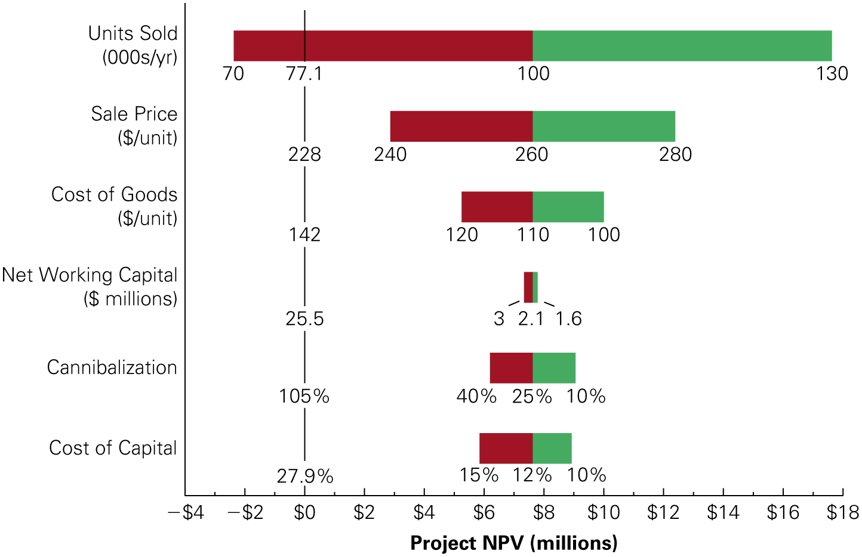
Figure 1 : HomeNet’s N P V Under Best-and Worst-Case Parameter Assumptions
Notes:
Long Description:
The horizontal axis represents project NPV in million ranging from negative 4 dollars to 18 dollars in increments of 2. The data are as follows: cost of capital: best-case, 10 percent; worst-case, 15 percent; breakeven point, 12 percent; total, 27.9 percent; cannibalization: best-case, 10 percent; worst-case, 40 percent; breakeven point, 25 percent; total, 105 percent; net working capital in million dollars, best-case, 1.6; worst-case, 3 percent; breakeven point, 2.1 percent; total, 25.5; cost of goods in dollars per unit, best-case, 100; worst-case, 120; breakeven point, 110; total, 142; sale price in dollars per unit, best-case, 280; worst-case, 240; breakeven point, 260; total, 228; units sold in thousands per year, best-case, 130; worst-case, 70; breakeven point, 100; total, 77.1.

Slide 62
Homenet Example 6 (1 of 2)
Sensitivity to Marketing and Support Costs
Problem
The current forecast for HomeNet’s marketing and support costs is $2.8 million per year during years 1–4. Suppose the marketing and support costs may be as high as $3.8 million per year. What is HomeNet’s N P V in this case?

Slide 63
Homenet Example 6 (2 of 2)
Solution
We can answer this question by increasing the selling, general, and administrative expense by $1 million in the spreadsheet in Table 5 (anchor table) and computing the N P V of the resulting free cash flow. We can also calculate the impact of this change as follows: A $1 million increase in marketing and support costs will reduce E B I T by $1 million and will, therefore, decrease HomeNet’s free cash flow by an after-tax amount of :
per year.
The present value of this decrease is
Home Net’s N P V would fall to
Notes:
Long description:
P V equals start fraction negative 0.8 over 1.12 end fraction plus start fraction negative 0.8 over 1.12 superscript 2 baseline end fraction plus start fraction negative 0.8 over 1.12 superscript 3 baseline end fraction plus start fraction negative 0.8 over 1.12 superscript 4 baseline end fraction equals negative 2.4 million dollars.

Slide 64
Scenario Analysis (1 of 2)
Scenario Analysis considers the effect on the N P V of simultaneously changing multiple assumptions
Table 16 : Scenario Analysis of Alternative Pricing Strategies
Strategy | Sale Price ($/unit) | Expected Units Sold(thousands) | NPV ($thousands)
Current strategy | 260 | 100 | $7627
Price reduction | 245 | 110 | $7032
Price increase | 275 | 90 | $7509

Slide 65
Scenario Analysis (2 of 2)
When there are many such cases, and managers have estimates of the likelihood of different outcomes, we can compute an expected N P V by weighting the N P V for each scenario by its probability
This expected N P V summarizes the expected value created by the decision after taking into account the key uncertainties

Slide 66
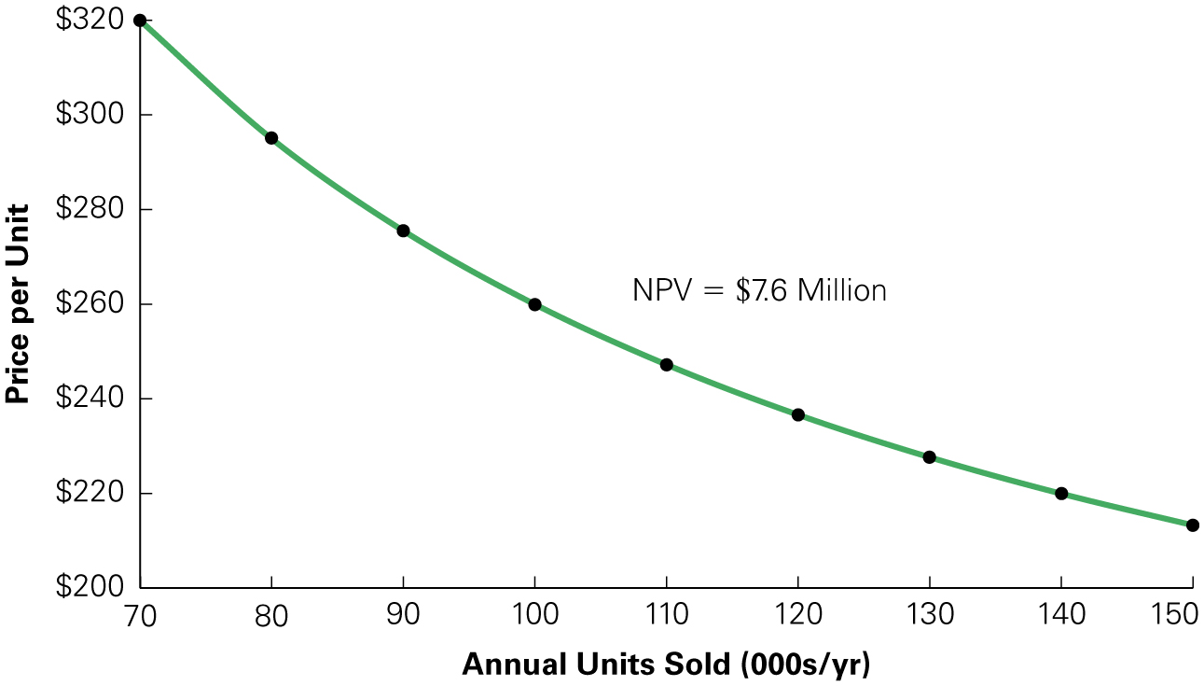
Figure 2 : Price and Volume Combinations for HomeNet with Equivalent N P V
Notes:
Long Description:
The horizontal axis shows the annual units sold in thousands per year ranging from 70 to 150 and the vertical axis shows the price per unit from 200 dollars to 320 dollars in increments of 20. The data points forming a curve are as follows: 70, 320 dollars; 80, 295 dollars; 90, 275 dollars; 100, 260 dollars; 110, 248 dollars; 120, 237 dollars; 130, 228 dollars; 140, 220 dollars; and 150, 212 dollars. The curve represents NPV equals 7.6 million dollars.

Slide 67
Chapter Quiz (1 of 2)
Should you include sunk costs in the cash flow forecasts of a project? Why or why not?
Should you include opportunity costs in the cash flow forecasts of a project? Why or why not?
What adjustments must be made to a project’s unlevered net income to determine its free cash flows?

Slide 68
Chapter Quiz (2 of 2)
How do you choose between mutually exclusive capital budgeting decisions?
Why is it advantageous for a firm to use the most accelerated depreciation schedule possible for tax purposes?
What is the terminal value of a project?
How does scenario analysis differ from sensitivity analysis?

Slide 69
Capital Budgeting
Msc Corporate Financial Management
Lille Campus - 18 hours
Skema Business School
Appendix
Pr. Sébastien DEREEPER
Sebastien.Dereeper@skema.edu
Course Based on :
J. Berk & P. De Marzo - Corporate Finance - Pearson, 2024
Notes:
If this PowerPoint presentation contains mathematical equations, you may need to check that your computer has the following installed:
1) Math Type Plugin
2) Math Player (free versions available)
3) NVDA Reader (free versions available)

Slide 70
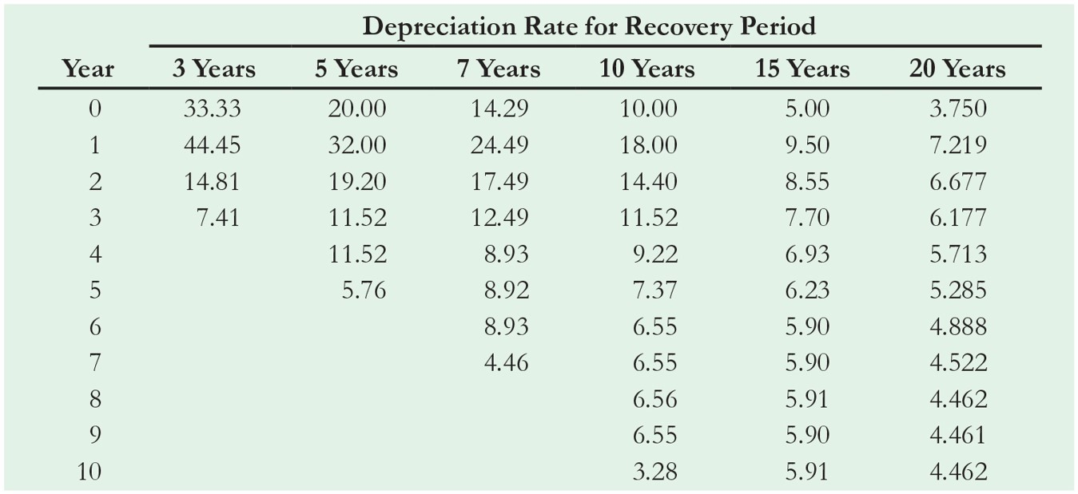
Table A1 (1 of 2)
M A C R S Depreciation Table Showing the Percentage of the Asset’s Cost That May Be Depreciated Each Year Based on Its Recovery Period
Notes:
Long Description:
The columns are year and depreciation rate for recovery period shows 3 years, 5 years, 7 years, 10 years, 15 years, and 20 years. The row-wise data is as follows: year, 0; 3 years, 33.33; 5 years, 20.00; 7 years, 14.29; 10 years, 10.00; 15 years, 5.00; 20 years, 3.750; year, 1; 3 years, 44.45; 5 years, 32.00; 7 years, 24.49; 10 years, 18.00; 15 years, 9.50; 20 years, 7.219; year, 2; 3 years, 14.81; 5 years, 19.20; 7 years, 17.49; 10 years, 14.40; 15 years, 8.55; 20 years, 6.677; year, 3; 3 years, 7.41; 5 years, 11.52; 7 years, 12.49; 10 years, 11.52; 15 years, 7.70; 20 years, 6.177; year, 4; 3 years, blank; 5 years, 11.52; 7 years, 8.93; 10 years, 9.22; 15 years, 6.93; 20 years, 5.713; year, 5; 3 years, blank; 5 years, 5.76; 7 years, 8.92; 10 years, 7.37; 15 years, 6.23; 20 years, 5.285; year, 6; 3 years, blank; 5 years, blank; 7 years, 8.93; 10 years, 6.55; 15 years, 5.90; 20 years, 4.888; year, 7; 3 years, blank; 5 years, blank; 7 years, 4.46; 10 years, 6.55; 15 years, 5.90; 20 years, 4.522; year, 8; 3 years, blank; 5 years, blank; 7 years, blank; 10 years, 6.56; 15 years, 5.91; 20 years, 4.462; year, 9; 3 years, blank; 5 years, blank; 7 years, blank; 10 years, 6.55; 15 years, 5.90; 20 years, 4.461; year, 10; 3 years, blank; 5 years, blank; 7 years, blank; 10 years, 3.28; 15 years, 5.91; 20 years, 4.462.

Slide 71
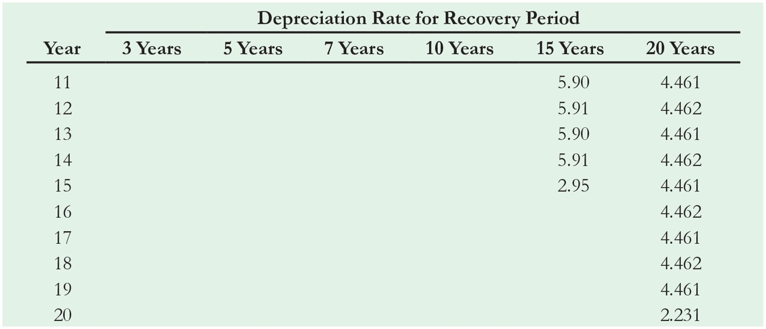
Table A1 (2 of 2)
M A C R S Depreciation Table Showing the Percentage of the Asset’s Cost That May Be Depreciated Each Year Based on Its Recovery Period
Notes:
Long Description:
The columns are year and depreciation rate for recovery period shows 3 years, 5 years, 7 years, 10 years, 15 years, and 20 years. The row-wise data is as follows: year, 11; 3 years, blank; 5 years, blank; 7 years, blank; 10 years, blank; 15 years, 5.90; 20 years, 4.461; year, 12; 3 years, blank; 5 years, blank; 7 years, blank; 10 years, blank; 15 years, 5.91; 20 years, 4.462; year, 13; 3 years, blank; 5 years, blank; 7 years, blank; 10 years, blank; 15 years, 5.90; 20 years, 4.461; year, 14; 3 years, blank; 5 years, blank; 7 years, blank; 10 years, blank; 15 years, 5.91; 20 years, 4.462; year, 15; 3 years, blank; 5 years, blank; 7 years, blank; 10 years, blank; 15 years, 2.95; 20 years, 4.461; year, 16; 3 years, 5 years, 7 years, 10 years, 15 years, blank; 20 years, 4.462; year, 17; 3 years, 5 years, 7 years, 10 years, 15 years, blank; 20 years, 4.461; year, 18; 3 years, 5 years, 7 years, 10 years, 15 years, blank; 20 years, 4.462; year, 19; 3 years, 5 years, 7 years, 10 years, 15 years, blank; 20 years, 4.461; year, 20; 3 years, 5 years, 7 years, 10 years, 15 years, blank; 20 years, 2.231.

